Slide 1
An Adaptive Algorithm for Grey Image Edge Detection Based on Grey Correlation Analysis
PDP8 group 881

Slide 2
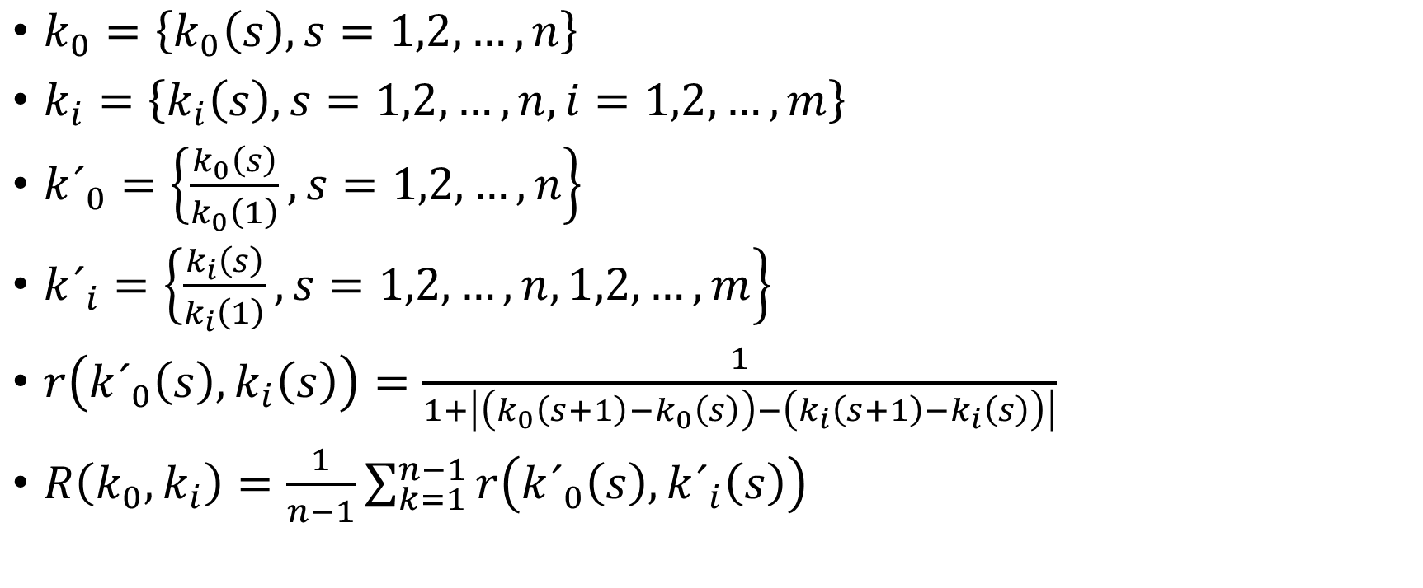
Grey Absolute Correlation Degree Model
$k_{0}=\left\{k_{0}\left(s\right), s=1,2,…,n\right\}$
$k_{i}=\left\{k_{i}\left(s\right), s=1,2,…,n, i=1,2,…,m\right\}$
$k´_{0}=\left\{\frac{k_{0}\left(s\right)}{k_{0}\left(1\right)}, s=1,2,…,n\right\}$
$k´_{i}=\left\{\frac{k_{i}\left(s\right)}{k_{i}\left(1\right)}, s=1,2,…,n, 1,2,…,m\right\}$
$r\left(k´_{0}\left(s\right),k_{i}\left(s\right)\right)=\frac{1}{1+\left|\left(k_{0}\left(s+1\right)−k_{0}\left(s\right)\right)−\left(k_{i}\left(s+1\right)−k_{i}\left(s\right)\right)\right|}$
$R\left(k_{0},k_{i}\right)=\frac{1}{n−1}\sum_{k=1}^{n−1}{r\left(k´_{0}\left(s\right),k´_{i}\left(s\right)\right)}$

Slide 3
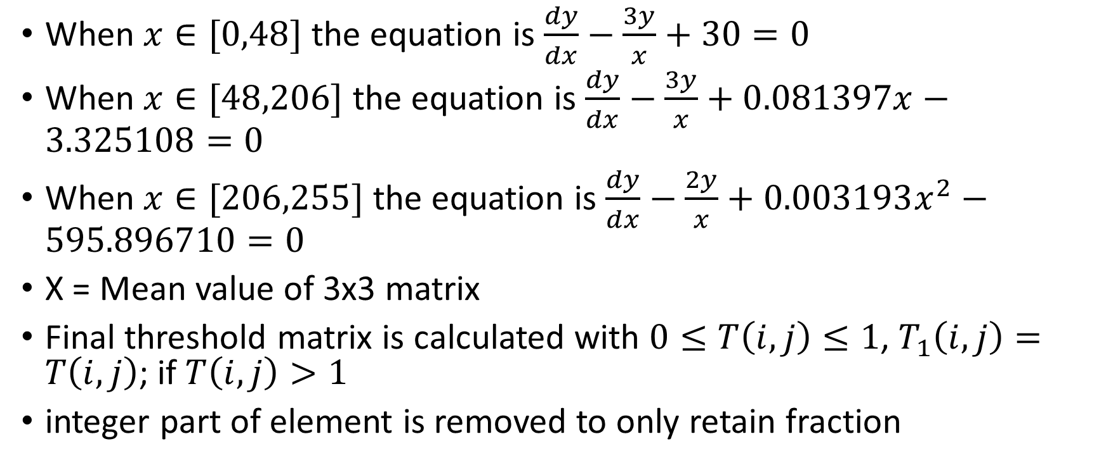
Adaptive Threshold Calculation
When $x∈[0,48]$ the equation is $\frac{dy}{dx}−\frac{3y}{x}+30=0$
When $x∈[48,206]$ the equation is $\frac{dy}{dx}−\frac{3y}{x}+0.081397x−3.325108=0$
When $x∈[206,255]$ the equation is $\frac{dy}{dx}−\frac{2y}{x}+0.003193x^{2}−595.896710=0$
X = Mean value of 3x3 matrix
Final threshold matrix is calculated with $0≤T\left(i,j\right)≤1$, $T_{1}\left(i,j\right)=T\left(i,j\right)$; if $T\left(i,j\right)>1$
integer part of element is removed to only retain fraction

Slide 4

Edge Extraction
If $R\left(i,j\right)<T_{1}(i,j)$ then $R\left(i,j\right)=0$
Otherwise $R\left(i,j\right)=1$
Results in detector image $I_{1}$

Slide 5
Eleminating Isolated Pixels
Erosion -> Dilation to remove non-edge pixels

Slide 6
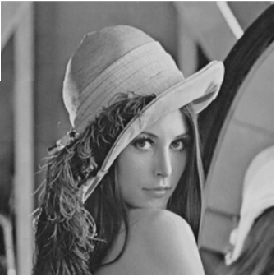
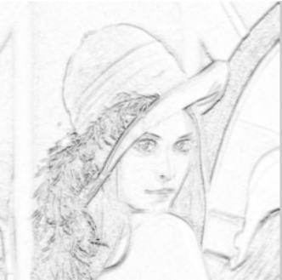
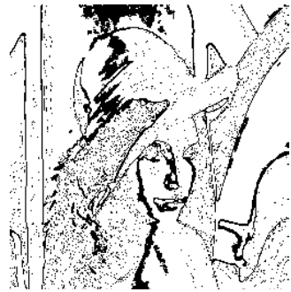
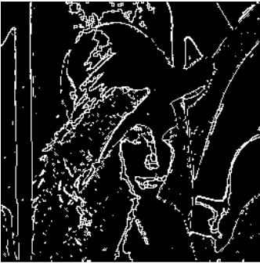
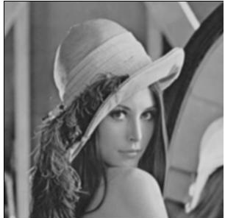
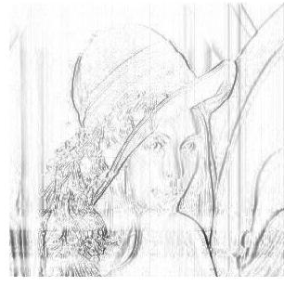
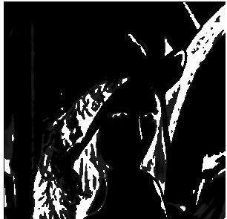
Comparison of Results

